Slide 1

Project Report for BS (CS-Evening)
Project Title:Railway Reservation System
Degree : BSCS (1-C)
Submitted to : Sir Hafiz Haseeb
Members :
Sayed Muhammad(24-ARID-987)
Ashiq Hussain(24-ARID-894)
Sayed Sibt Hussain(24-ARID-988)

Slide 2
Abstract:
The Railway Reservation System is a C++ console application designed to automate the reservation process of a railway system. It provides functionalities for managing trains, customers, finances, and fares. The system ensures a user-friendly interface for railway administrators, enabling efficient handling of railway operations.

Slide 3
Project Features:
Admin Login: Secure login system for railway administrators.
Manage Trains: Ability to add, delete, and update train information.
Manage Customers: Ability to add and update customer information.
Manage Finance: Generate monthly financial reports.
Manage Fares: Update fare information for trains.
Menu-Driven Interface: Easy navigation through different functionalities using a simple menu system.

Slide 4
Code Explanation:
Structs:
Admin: Stores the username and password of the admin.
Train: Stores the ID, name, route, and number of seats of each train.
Customer: Stores the ID, name, and reserved train ID of each customer.

Slide 5
Constants:
Admin admin: Initializes the admin credentials.
Train trains[100]: Array to store up to 100 trains.
Customer customers[100]: Array to store up to 100 customers.
int trainCount: Variable to keep track of the number of trains added.
int customerCount: Variable to keep track of the number of customers added.
float fares[100]: Array to store fare information for up to 100 trains.

Slide 6
Functions:
Admin Login: Verifies the admin credentials to allow access to the system.
Display Admin Menu: Displays the admin menu with options for managing trains, customers, finance, and fares.
Manage Trains: Functions to add a new train, delete a train by its ID, and update train information.
Manage Customers: Functions to add a new customer and update customer information by their ID.
Generate Monthly Report: Calculates and displays the total number of trains, total seats, reserved seats, and monthly revenue.
Manage Fares: Function to update fare information for each train.

Slide 7
Main Function:
Initialization
Initializes the admin credentials and prepares the program for user interaction.
Menu System and Usage
The menu system allows the admin to choose between managing trains, customers, finance, or fares, and also provides an option to log out of the system.

Slide 8
Notes:
User-Friendly Interface: The menu-driven interface ensures ease of use for administrators.
Data Storage: Trains and customers are stored in arrays, which allows for simple addition, deletion, and updating of records.
Error Handling: Basic error handling is included to notify the user if a train or customer is not found during deletion or updating operations.

Slide 9
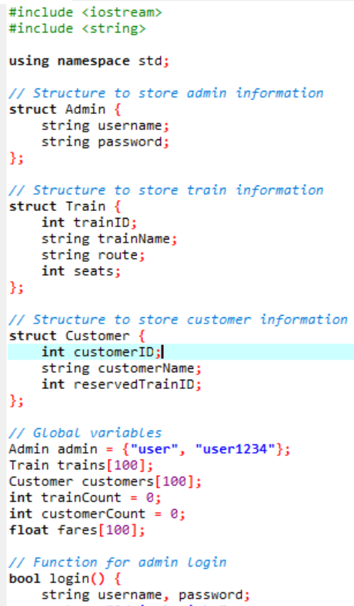
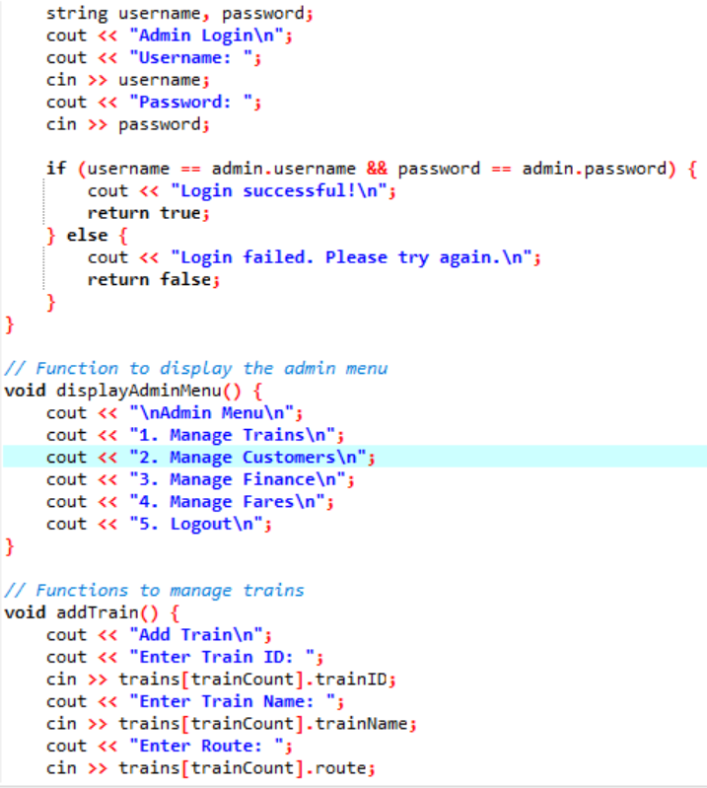
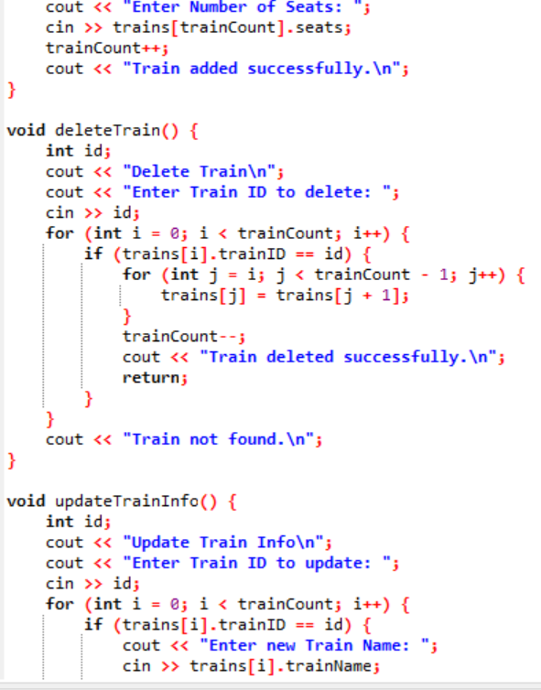
Source Code:

Slide 10
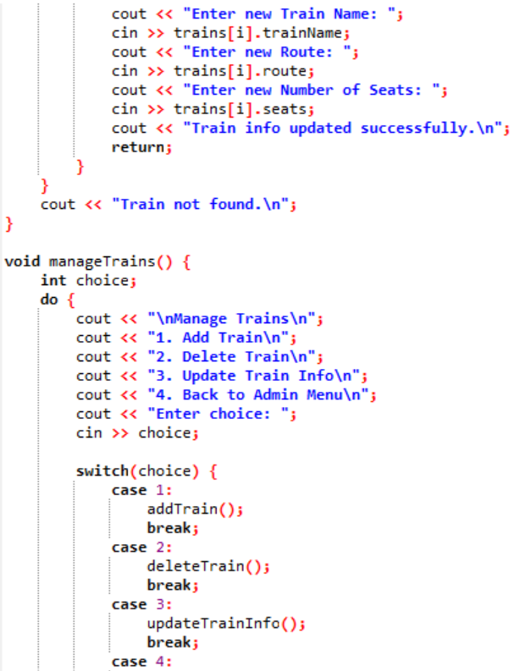
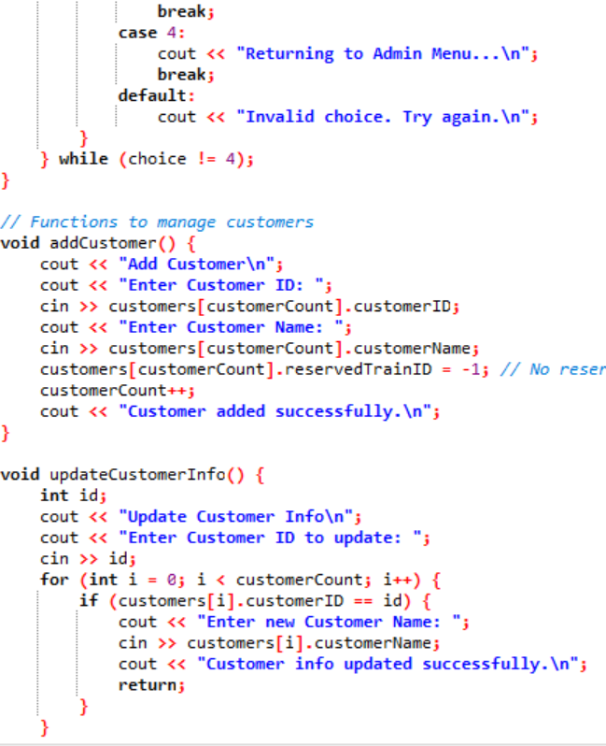
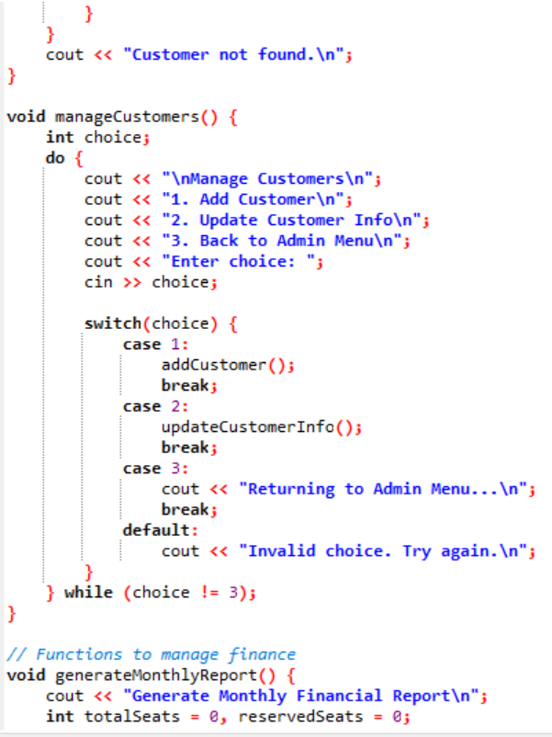

Slide 11
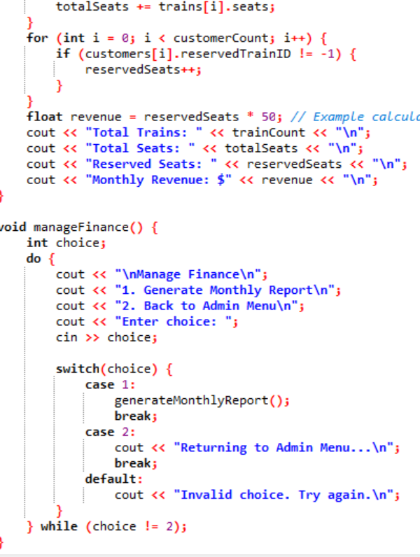
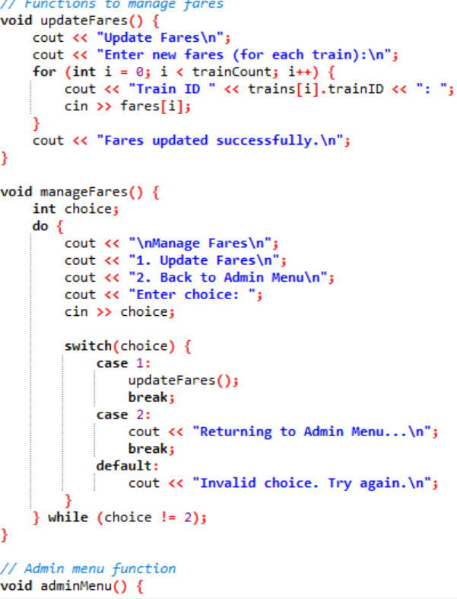
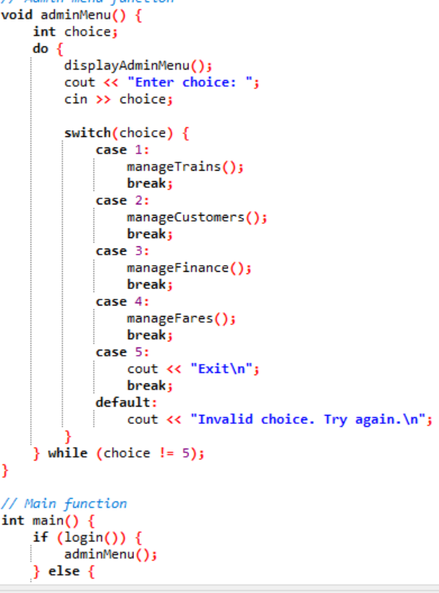

Slide 12
